Slide 1
Introduction to
AWS System Manager
Parameter Store

Slide 2

AWS SSM Parameter Store
Why Centralized Configuration?
If maintaining a single configuration for a large application is difficult, imagine maintaining configurations for hundreds of microservices in different environments.
Config data might be hard-coded in plaintext in the source code or accessed from config files (or other locations) manually. This is not scalable, and more important, from a security standpoint, not recommended.
Providing granular access control is difficult, especially if the parameters are used in customer-facing or production infrastructure.
Data is sometimes stored outside your environment crossing trust boundaries, and requiring more tools to manage.

Slide 3

AWS SSM Parameter Store
What kind of stuff we could store centralized?
To list some:
Infra configuration
Application configuration.
Database configuration.
Communication Channel Configuration - queues and other infrastructure.
URLs of other microservices to talk to.
Any kind of secrets

Slide 4

AWS SSM Parameter Store
What benefits are offered by Parameter Store
To list the most important ones (at least for me):
No servers to manage.
Use a secure, scalable, hosted secrets management service with no servers to manage.
Store configuration data and secure strings in hierarchies and track versions.
Improve your security posture by separating your data from your code.
Control and audit access at granular levels.
Configure change notifications and trigger automated actions for both parameters and parameter policies.
Tag parameters individually
Out of the box integration with other AWS services

Slide 5

AWS SSM Parameter Store
Different types of Systems Manager parameters
You can store data such as passwords, database strings, and license codes as parameter values etc.
You could store data as
String
String List
Secured String
You can reference Systems Manager parameters in your scripts, commands, SSM documents, and configuration and automation workflows.
Esta foto de Autor desconocido está bajo licencia CC BY-SA

Slide 6
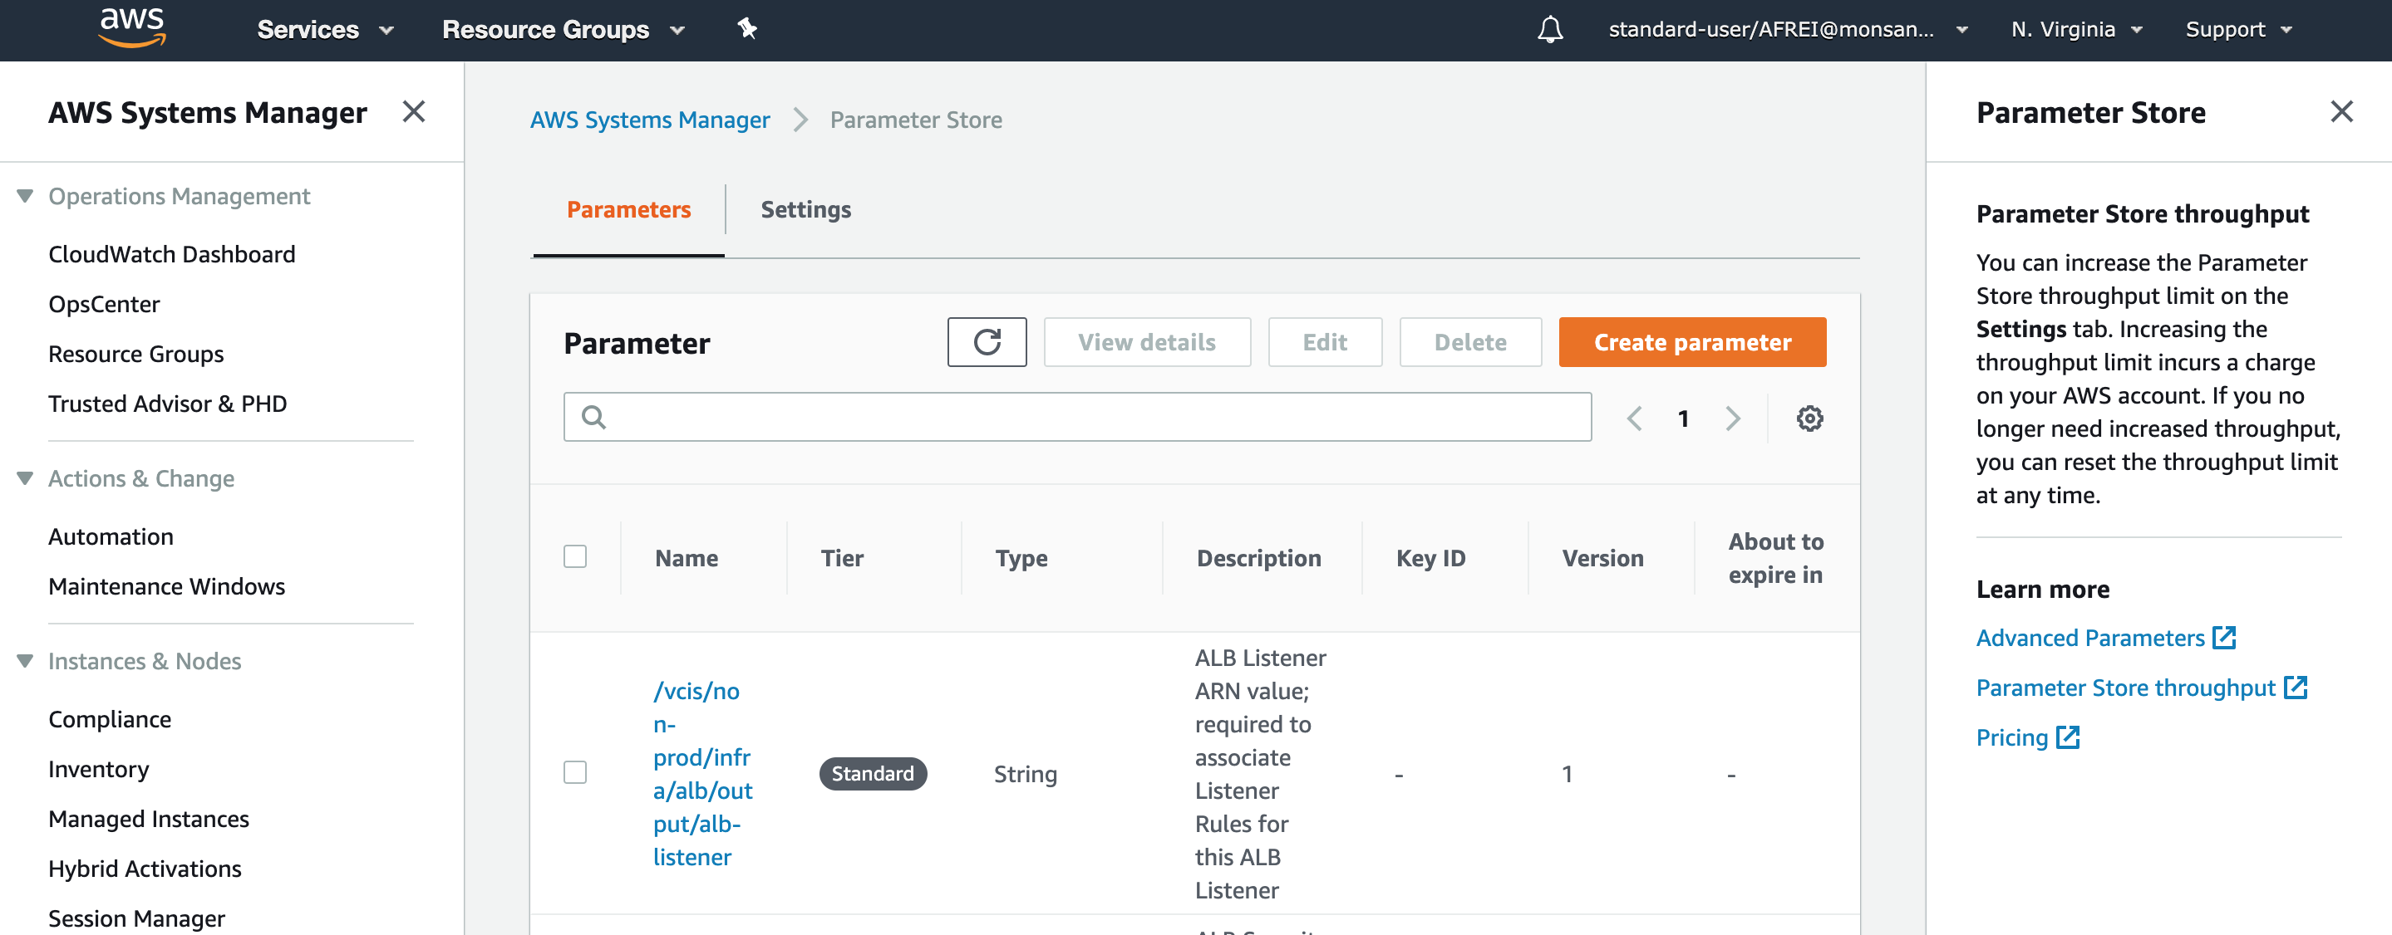
AWS SSM Parameter Store
A very quick demo

Slide 7
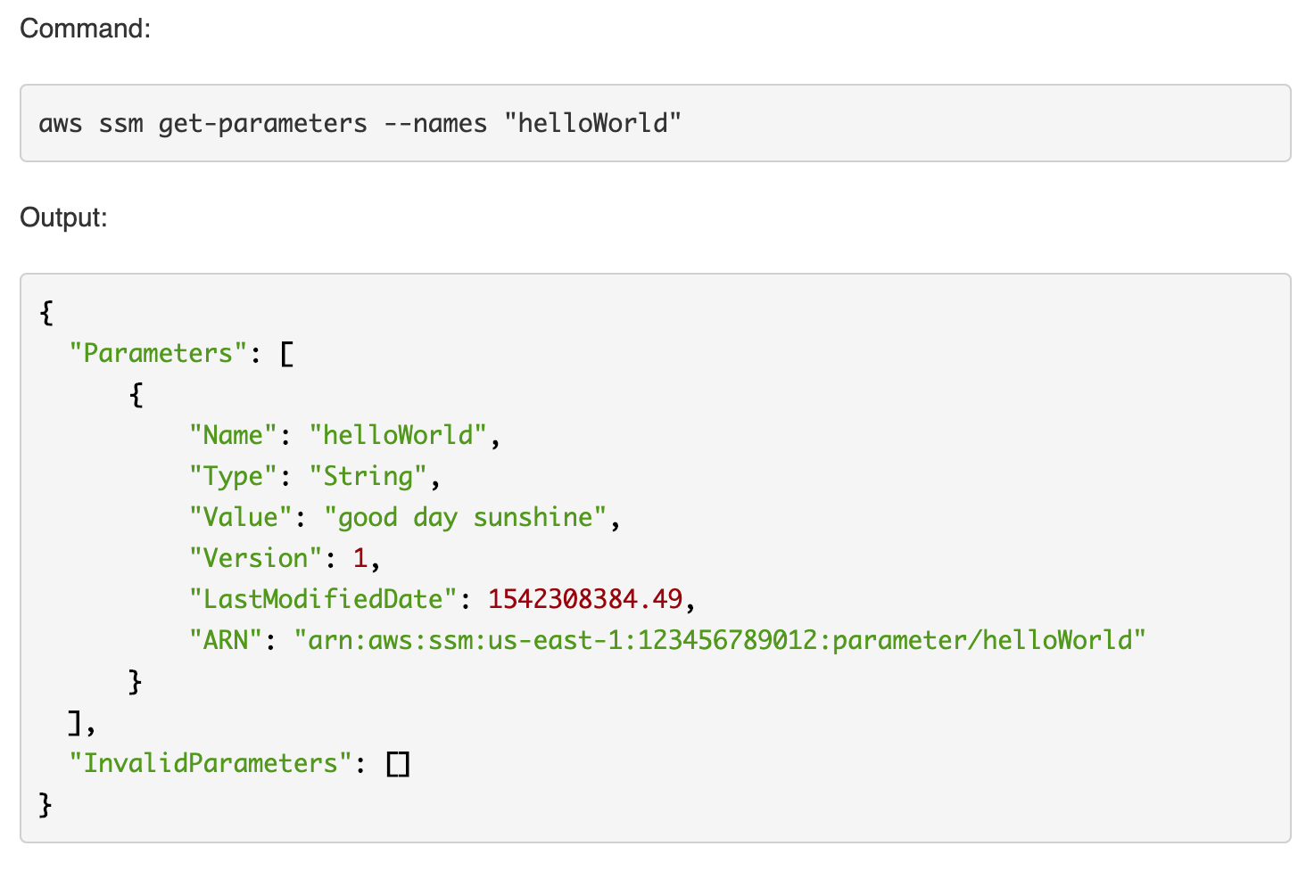
AWS SSM Parameter Store
A very quick demo

Slide 8
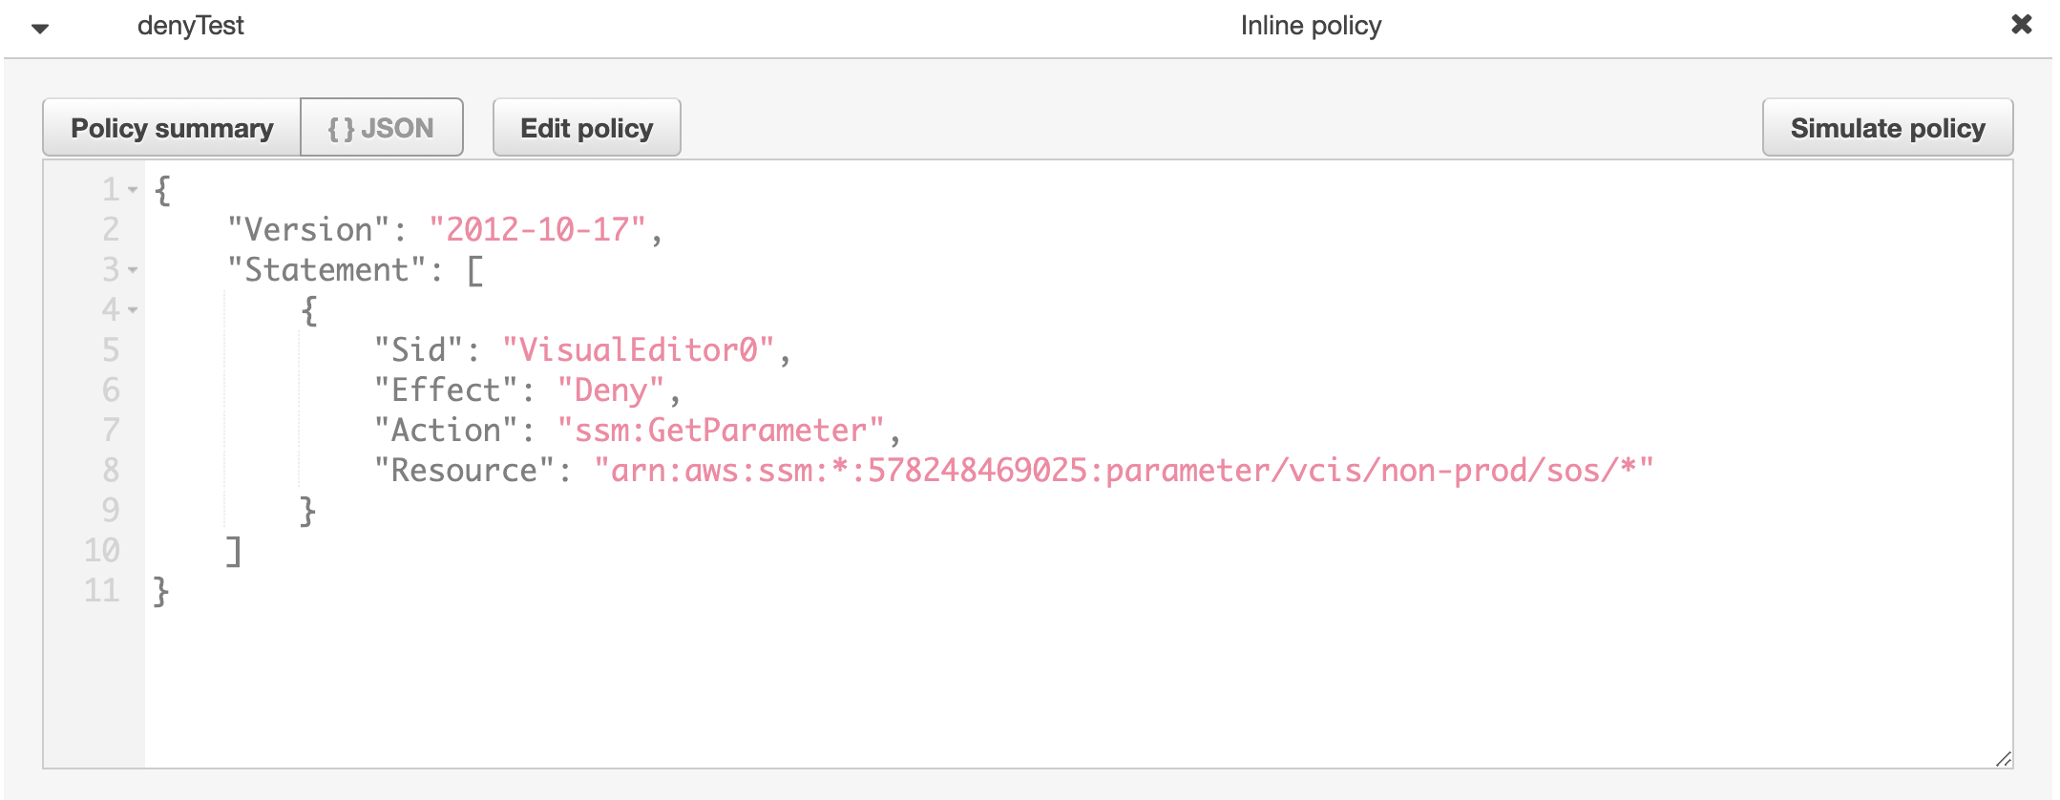
AWS SSM Parameter Store
A very quick demo

Slide 9
AWS SSM Parameter Store
How we are using it at Indystry System?
Already being used:
To store shared tags between different Cfn stacks
To store infraestructure configurations
To reference CFn Stacks outputs as inputs in other dependant CFn Stacks (that we still don’t want to heavy couple)
Ready to use on Node apps with Pod Node Lib!
To store app configuration for all our lambdas and ms
To store secrets that don’t need to be rotated

Slide 10
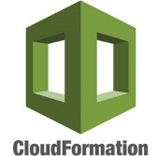
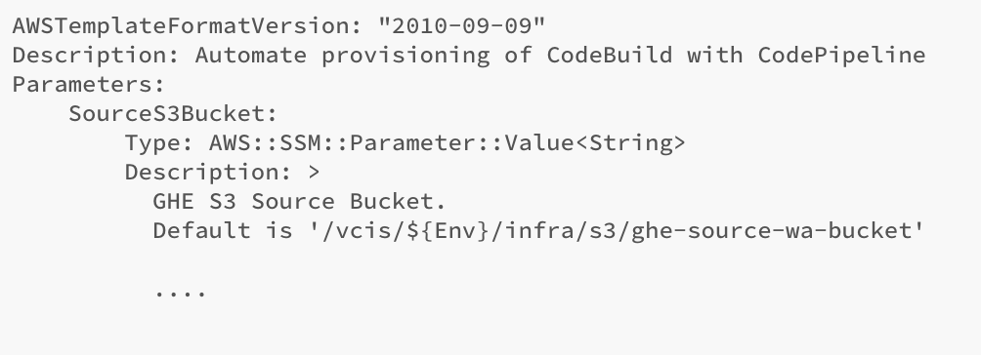
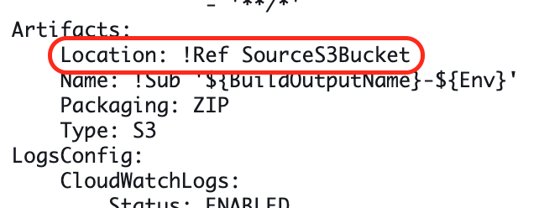
AWS SSM Parameter Store
How we are using it at Indystry System? – Cloud Formation Templates
CloudFormation
template extract
Esta foto de Autor desconocido está bajo licencia CC BY

Slide 11

AWS SSM Parameter Store
How we are using it at Indystry System? - POD node lib - Finance loader
The finance-config-loader (version 2.0.0 or higher) supports integration with AWS System Manager Parameter Store through the custom reader 'AWS_SSM'. This reader accepts the following parameters:
value
Description: path to the SSM Parameter store entry
Type: string
Required: yes
decrypt
Description: specifies if the SSM Parameter is a Secured String and needs to be decrypted
Required: no
Default Value: false
https://github.platforms.engineering/POD-Inc/pod-node-library/tree/develop/finance-config-loader
Esta foto de Autor desconocido está bajo licencia CC BY-SA

Slide 12
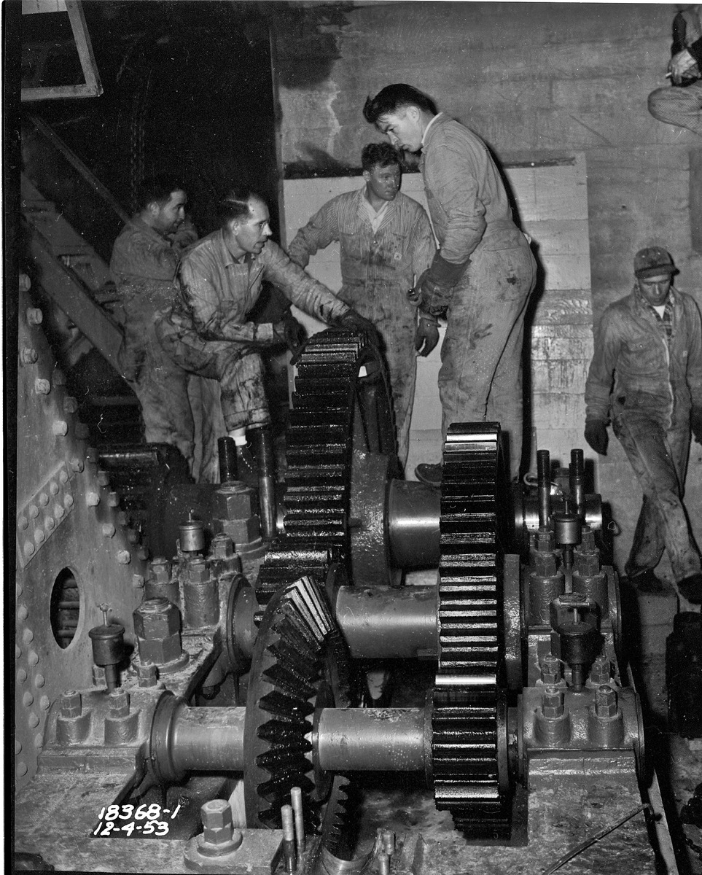
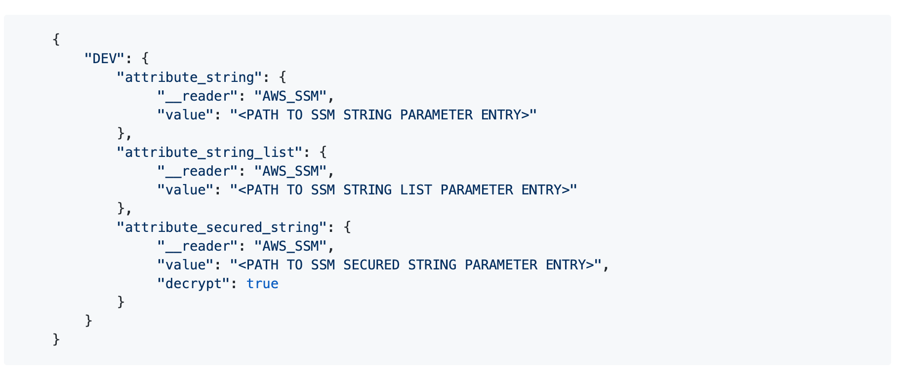
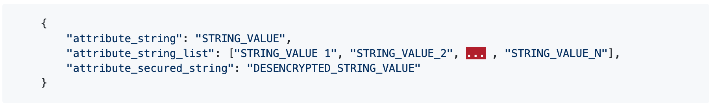
AWS SSM Parameter Store
How we are using it at Indystry System? - POD node lib - Finance loader
Esta foto de Autor desconocido está bajo licencia CC BY-SA
Esta foto de Autor desconocido está bajo licencia CC BY-SA

Slide 13

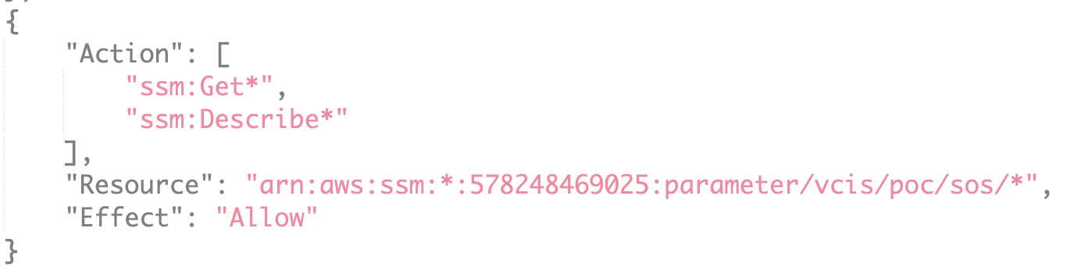
AWS SSM Parameter Store
How we are using it at Indystry System? - POD node lib - Finance loader
Remeber to define the needed policies so your Lambda function has permission to read you SSM parameters ;)

Slide 14


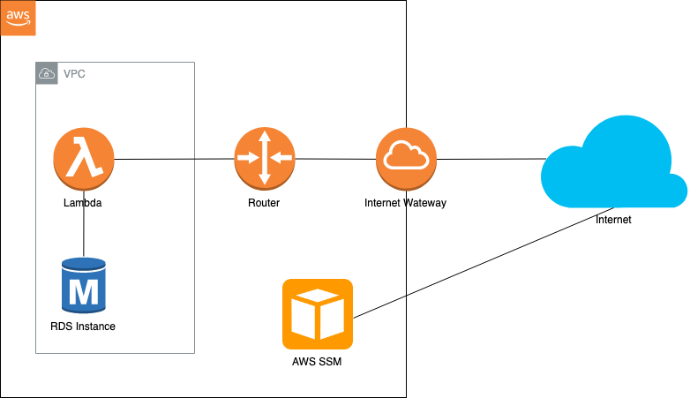
AWS SSM Parameter Store
Wanna access SSM on a Lambda Function? Some considerations
If your lambda is running inside a VPC, then the lambda will not have access to internet and will not be able to fetch SSM Parameter Store.
Open a NAT gateway on the VPC to enable internet traffic (not that secure)
Esta foto de Autor desconocido está bajo licencia CC BY-SA
Esta foto de Autor desconocido está bajo licencia CC BY
Esta foto de Autor desconocido está bajo licencia CC BY-SA

Slide 15

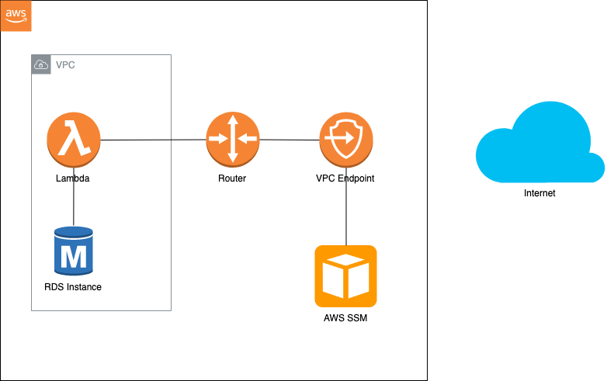
AWS SSM Parameter Store
Wanna access SSM on a Lambda Function? Some considerations
If your lambda is running inside a VPC, then the lambda will not have access to internet and will not be able to fetch SSM Parameter Store.
Creating VPC EndPoints for Systems Manager
Esta foto de Autor desconocido está bajo licencia CC BY-SA
Esta foto de Autor desconocido está bajo licencia CC BY
Esta foto de Autor desconocido está bajo licencia CC BY-SA

Slide 16

AWS Secrets Manager
Why?
enables you to easily rotate, manage, and retrieve secrets such us:
Database credentials
API keys
Others
Esta foto de Autor desconocido está bajo licencia CC BY-SA-NC

Slide 17
AWS Secrets Manager
What benefits are offered by Secrets Manager
To list the most important ones (at least for me):
No servers to manage.
Rotate secrets safely
Manage access with fine-grained policies
Secure and audit secrets centrally
Pay as you go

Slide 18
AWS Secrets Manager
A very quick demo? Not today… may be next time
We have been working on POC for Industry System in order to replace Vault with SSM Secrets Manager to store DB Credentials (or any secret that needs to be rotated)
We have a working POC with integration with a lambda with SSM Secrets Manager
We have working POC to configure rotation for DB credentials covering
Single User Schema
Multi User Schema

Slide 19

Useful links
https://docs.aws.amazon.com/systems-manager/latest/userguide/systems-manager-parameter-store.html
https://docs.aws.amazon.com/systems-manager/latest/userguide/sysman-paramstore-cwe.html
https://docs.aws.amazon.com/secretsmanager/latest/userguide/intro.html
Thanks!
Axel Freiria
Fullstack Dev
Contact axel.freiria@bayer.com

